Slide 1

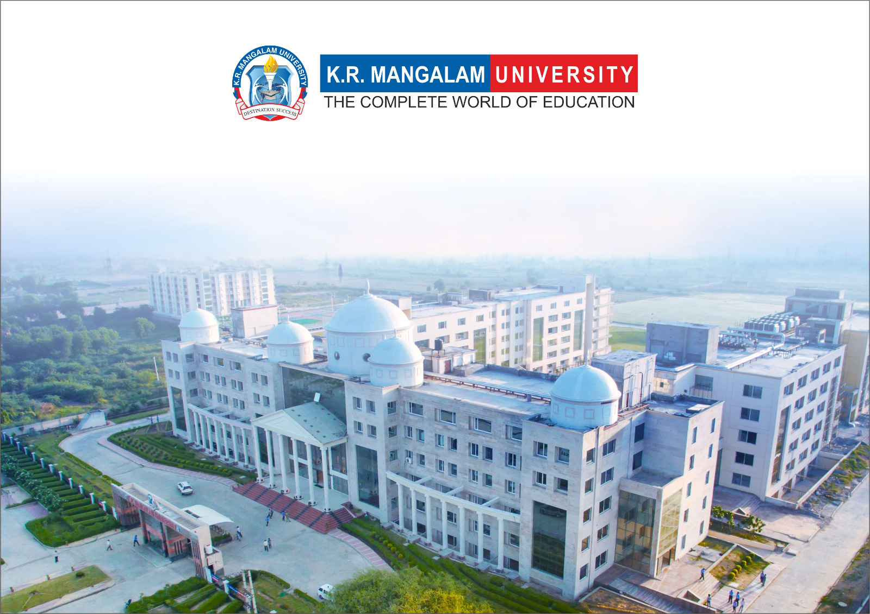
Introduction to Water Chemistry & Hardness
Course Code: ETMLCH104
Course Name: Engineering Chemistry
Program: B.Tech. (AI/ML)
Unit1:Water technology & Chemical Fuels
Dr Pratibha Sharma
Assistant Professor, Department of Chemistry
School of Basic and Applied Sciences
K.R. Mangalam University
Sohna Road, Gurugram

Slide 2

Course Overview
Unit Number: 1 | Title: Water technology | No. of hours: 6
Introduction, water analysis: Hardness-determination by EDTA method, Treatment of boiler feed water: Internal treatment (Phosphate, Colloidal and Calgon conditioning). External treatments: Ion exchange and lime-soda process, Zeolite processes. Boiler scales formation and ill effects, methods of prevention of scales. Numerical problems
Unit Number: 2 | Title: Chemical Fuels | No. of hours: 9
Fuels: Introduction, classification, calorific value (HCV & LCV), Determination of calorific value of fuel using Bomb calorimeter. Solid fuel: Coal- its analysis by proximate and ultimate analysis, Numerical problems. Liquid fuels: Refining of petroleum, Petroleum cracking, Knocking in IC engine, its ill effects and prevention of knocking. Anti-knocking agent: Leaded and unleaded petrol. Gaseous fuels: LPG, CNG and their applications.
Unit Number: 3 | Title: Battery Technology | No. of hours: 10
Introduction - Galvanic cell, electrode potential, EMF of the cell and cell representation. Batteries and their importance, Classification of batteries- primary, secondary and reserve batteries with examples. Battery characteristics - voltage, capacity, energy density, power density, energy efficiency, cycle life and shelf life. Construction, working and applications of: Ni-Cd, and Lithium-ion battery. Working principle of an electric vehicle.
Unit Number: 4 | Title: Polymer | No. of hours: 5
Basic concepts of polymer, Types of polymers, Thermoplastic & thermosetting plastics, Preparation and application of some industrially important polymers (Natural rubber, Buna S, Buna-N, Neoprene, Isoprene, Nylon-6, nylon-6,6 , Decron and Terylene). Conducting and biodegradable polymers.

Slide 3
COURSE OUTCOMES
CO1: Understand the methods for water hardness and the basics of boiler water treatment and analyze fuel calorific values and battery.
CO2: Explain the characteristics and working principles of different battery types and types of fuels.
CO3: Determine the differences between batteries and fuel cells and classify fuel cell types based on their components..
CO4: Identify between hard and soft water, solve the related numerical problems on water purification and emf and its significance in industry and daily life.

Slide 4
External treatments
Ion Exchange and Zeolite Process

Slide 5
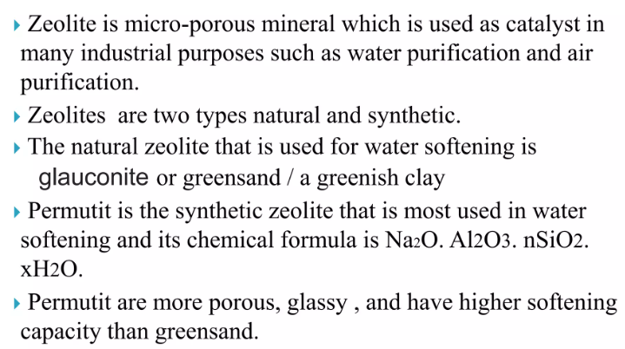
Zeolite

Slide 6

Techniques for water softening (External treatment)
a) Zeolite process
The chemical formula of zeolite is hydrated sodium aluminum silicate represented as Na₂OAl₂O₃.xSiO₂.yH₂O (x = 2-10 & y = 2- 6).
Zeolites are capable exchanging ions with sodium ions. So it is capable of exchanging hardness producing icons present in water.
This process also called as permutit process. Zeolite can be written as Na₂Ze The two Na⁺ icons is replaced by one Ca²⁺ or Mg²⁺ ions.

Slide 7
Techniques for water softening (External treatment)
a) Zeolite process
Na₂Ze + Ca²⁺ CaZe + 2Na⁺
Reaction:-
Na₂Ze + CaCl₂/CaSO₄/ Ca(HCO₃)₂ CaZe + 2NaCl/Na₂SO₄/2NaHCO₃

Slide 8
Techniques for water softening (External treatment)

Slide 9
Techniques for water softening (External treatment)
Regeneration:Exhausted zeolite can be regenerated by treating it with brine solution (10% NaCl solution)
(Ca²⁺/Mg²⁺) Ze + NaCl Na₂Ze + CaCl₂ (or) MgCl₂

Slide 10
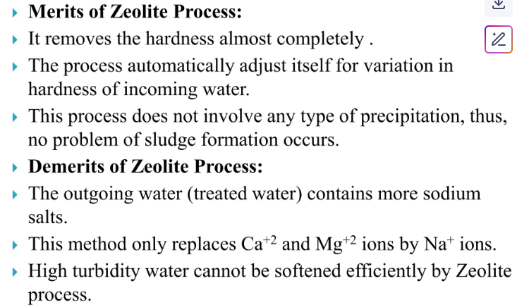

Slide 11
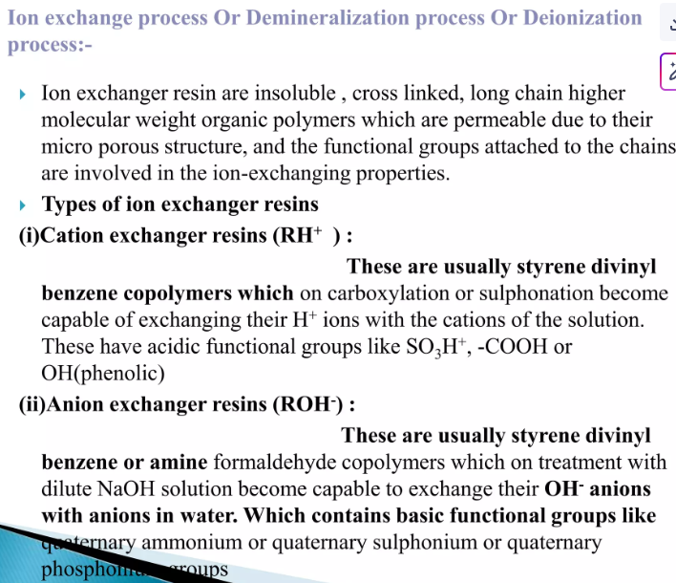

Slide 12
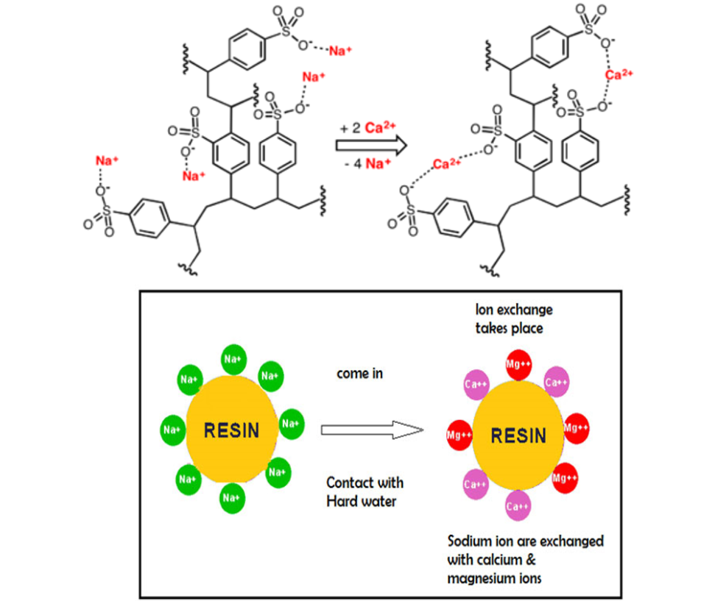

Slide 13
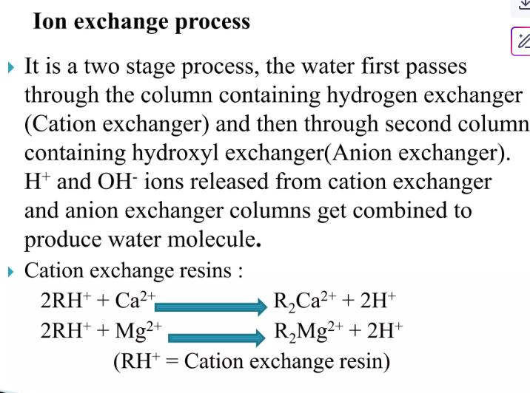

Slide 14
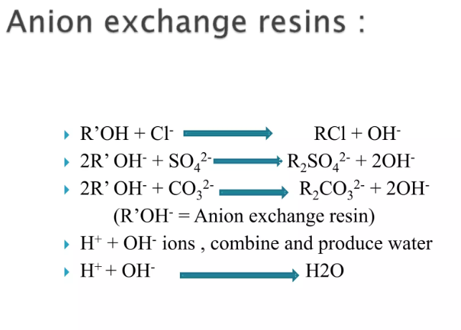

Slide 15

Techniques for water softening (External treatment)
b) Ion-exchange resin:
In this process cations and anions are completely removed by passing impure water into two different columns. First column contain sulphuric acid resin with acidic group –SO₃H. This column is known as cation exchange resin because it exchange
only cations like Ca²⁺, Mg²⁺, Na⁺ etc.
Resin–SO₃H + Na⁺ resin- 𝑆𝑂₃−Na⁺ + H⁺
2Resin–SO₃H + Ca²⁺ (resin- 𝑆𝑂₃)₂Ca + 2H⁺
2Resin–SO₃H + Mg²⁺ (resin- 𝑆𝑂₃)₂Mg + 2H⁺
Whereas, second column contain resin with basic group like –𝑁𝑅₃ + 𝑂𝐻⁻. It is known as anion exchange resin because it exchanges anions like 𝐶𝑙⁻, 𝑆𝑂₄²⁻ etc.
resin–𝑁𝑅₃⁺ 𝑂𝐻⁻ + 𝐶𝑙 ⁻ − resin–𝑁𝑅₃ + 𝐶𝑙⁻ + 𝑂𝐻⁻
The removal of H⁺ ions from the first column and 𝑂𝐻⁻ ions from the second column react to form water.

Slide 17
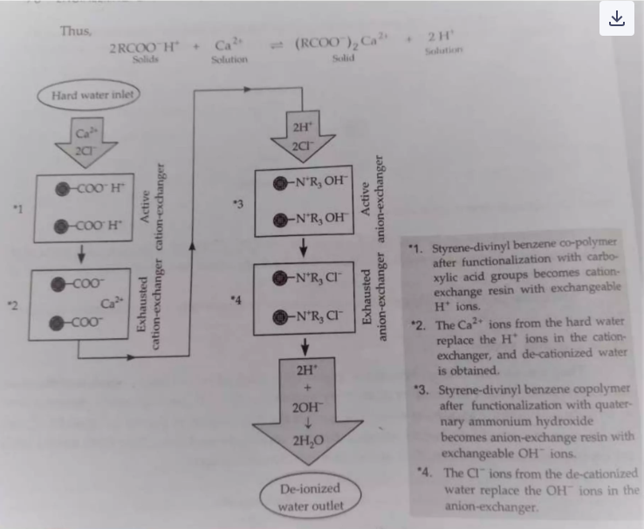

Slide 18
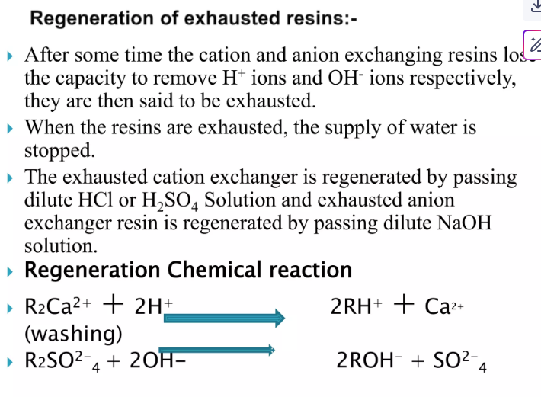

Slide 19
Techniques for water softening (External treatment)
Regeneration:
when both the column are exhausted, then first and second column are treated with dilute sulphuric acid or HCl (generate H⁺ ions) and aqueous NaOH (generate OH– ions) respectively. So, they have to be regenerated.
(resin- 𝑆𝑂₃)₂Ca + 2H⁺ 2Resin–SO₃H + Ca²⁺
(resin- 𝑆𝑂₃ )₂Mg + 2H⁺ 2Resin–SO₃H + Mg²⁺

Slide 20
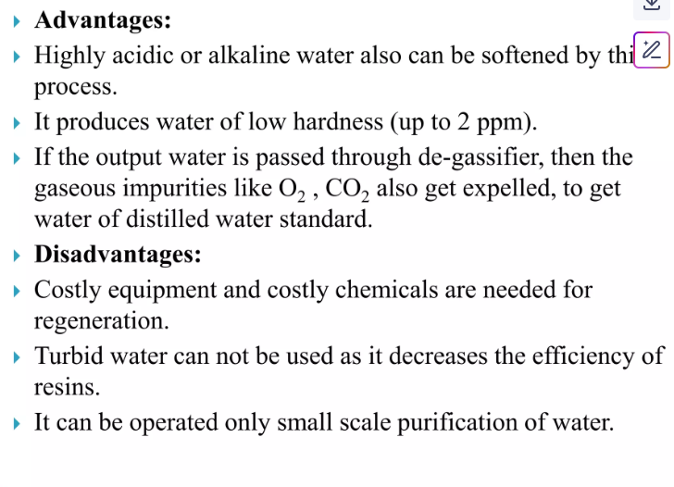

Slide 21
Take away of the process
Purpose: Removes hardness (Ca²⁺, Mg²⁺) from water by ion exchange.
Working Principle: Hardness-causing ions are exchanged with sodium (Na⁺) ions in zeolite.
Material Used: Natural or synthetic zeolite (sodium aluminum silicate).
Regeneration: Done using brine solution (NaCl) to restore sodium ions in zeolite.
Application: Used in domestic, industrial, and boiler water softening.

Slide 22
Take away of the process
Removes hardness and dissolved salts by exchanging ions in water with those on a resin.
Two types: Cation exchange (for Ca²⁺, Mg²⁺) and anion exchange (for Cl⁻, SO₄²⁻).
Resins require periodic regeneration using chemicals like NaCl or acids.
Produces high-purity water ideal for boilers, pharmaceuticals, and electronics.
Not effective against organics or turbidity – pre-treatment may be needed.

Slide 23
Questions
1.What is the primary purpose of the zeolite method in water treatment? A. Sterilizing water B. Softening hard water C. Removing color D. Adjusting pH
2. Which ions are removed from water using the zeolite method? A. Na⁺ and K⁺ B. Cl⁻ and SO₄²⁻ C. Ca²⁺ and Mg²⁺ D. NO₃⁻ and CO₃²⁻
3. What is zeolite typically regenerated with? A. Lime water B. Sodium chloride (brine) C. Potassium permanganate D. Sulfuric acid
4. What type of compound is zeolite? A. Sodium bicarbonate B. Sodium aluminum silicate C. Magnesium carbonate D. Calcium sulfate
5. Which of the following is a limitation of the zeolite method? A. Cannot remove iron or manganese effectively B. Requires high temperature C. Uses expensive chemicals D. Produces acidic water

Slide 24
Questions
What is the primary purpose of the ion exchange method in water treatment? A. Disinfection of water B. Removal of suspended solids C. Removal of hardness and dissolved ions D. Aeration of water
In the ion exchange method, which ions are typically removed during cation exchange? A. Na⁺ and K⁺ B. Cl⁻ and NO₃⁻ C. Ca²⁺ and Mg²⁺ D. HCO₃⁻ and SO₄²⁻
What is commonly used to regenerate a sodium-based ion exchange resin? A. HCl B. NaCl C. H₂SO₄ D. NH₄OH
Which of the following is a limitation of the ion exchange method? A. High electricity consumption B. Cannot remove dissolved salts C. Ineffective against organic matter and turbidity D. Requires ultraviolet light
Which type of water treatment is best suited for the ion exchange process? A. Wastewater with high turbidity B. Boiler feed water requiring high purity C. Rainwater harvesting D. Stormwater drainage

Slide 25
References
Engineering Chemistry by Jain and Jain.

